Slide 2
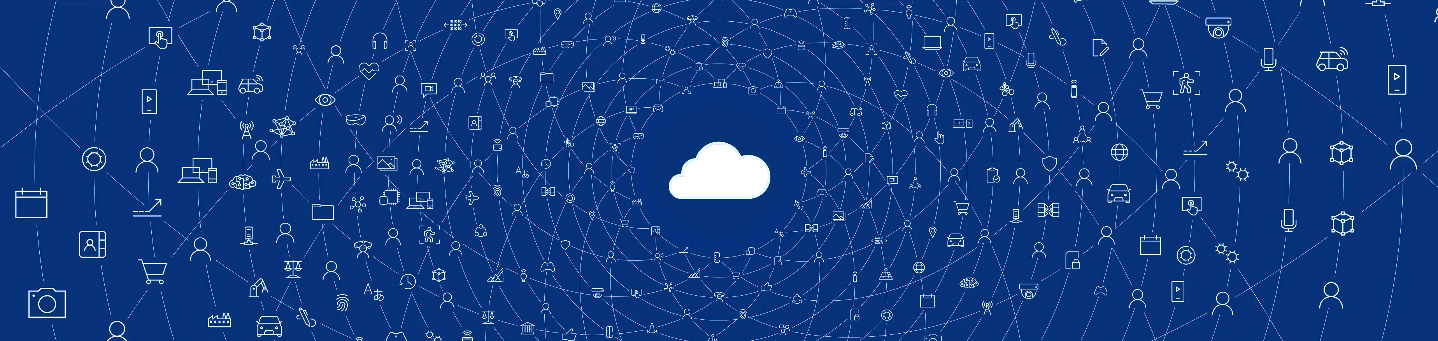


“The most profound technologies are those that disappear. They weave themselves into the fabric of everyday life until they are indistinguishable from it.”
Mark Weiser

Slide 3
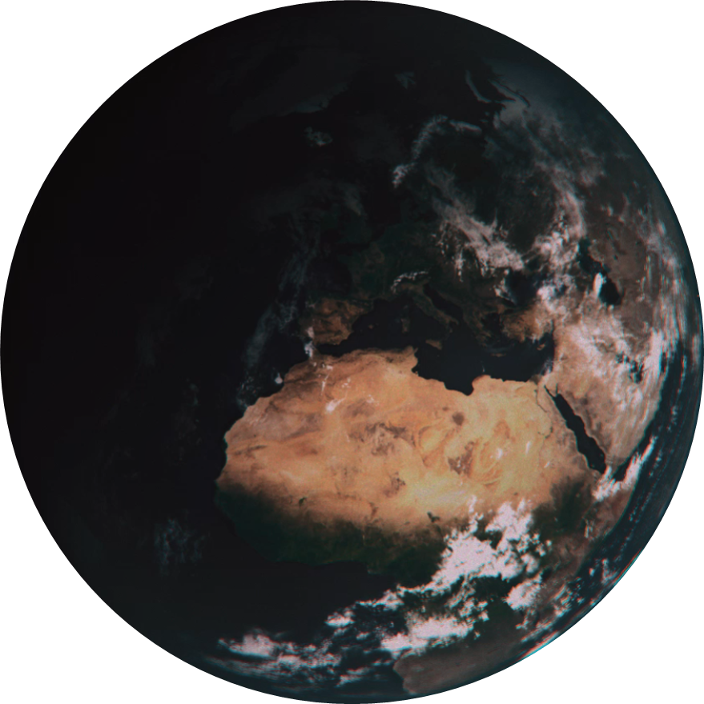


Opportunity

Slide 4




Slide 5
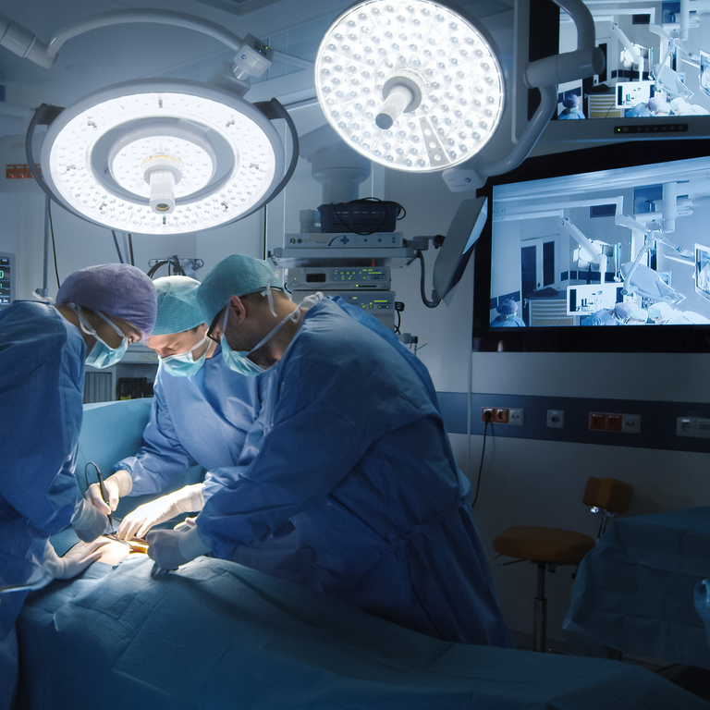
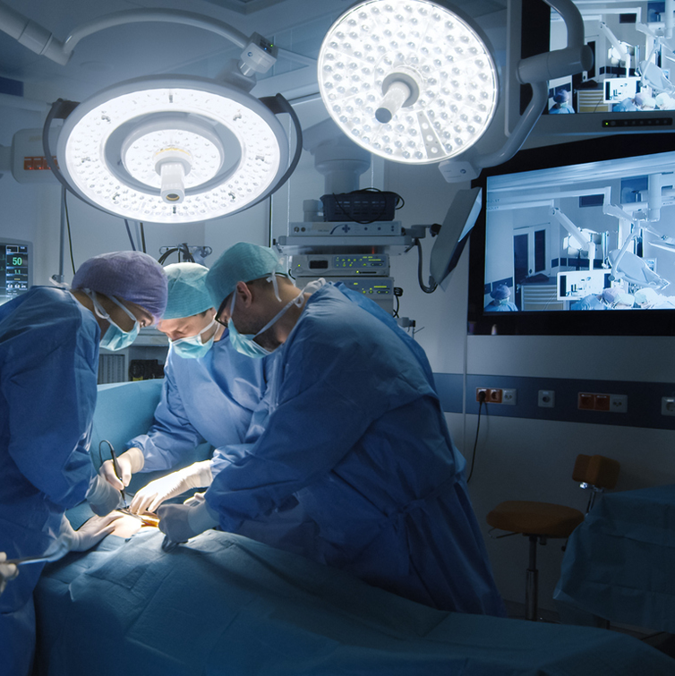

Slide 6
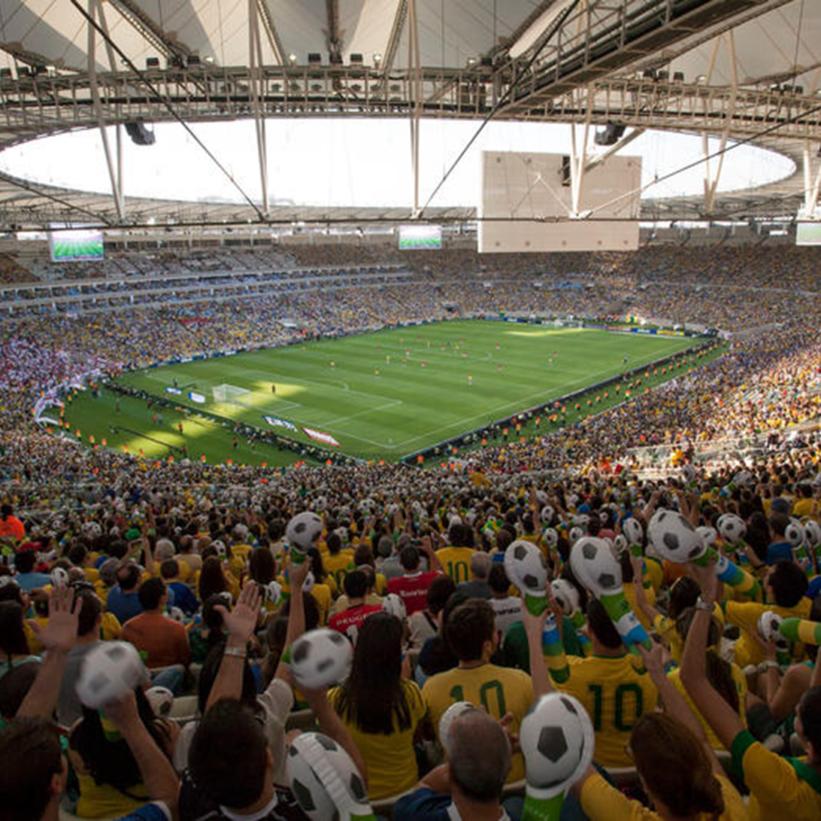

Slide 7


Slide 8
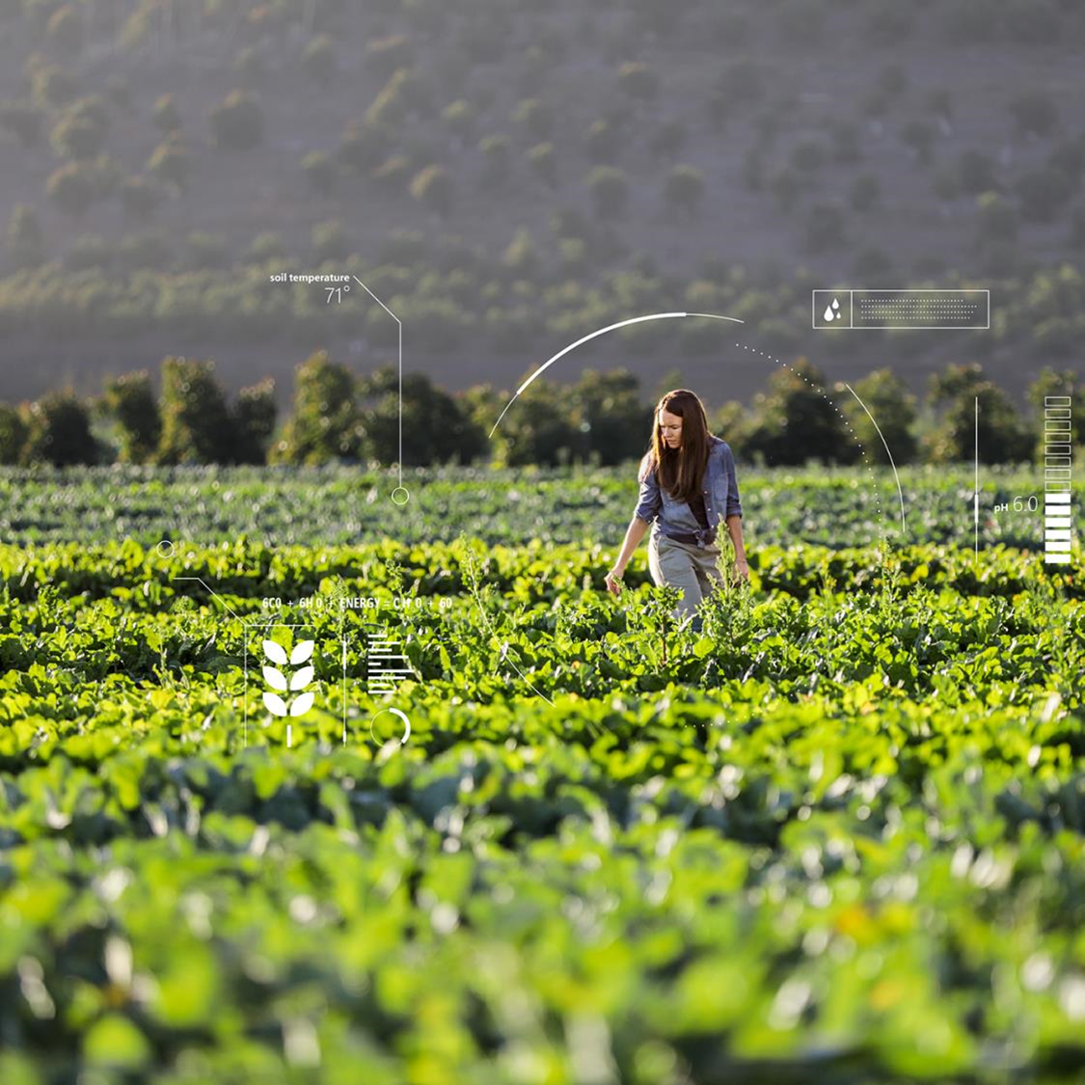

Slide 9



Slide 10
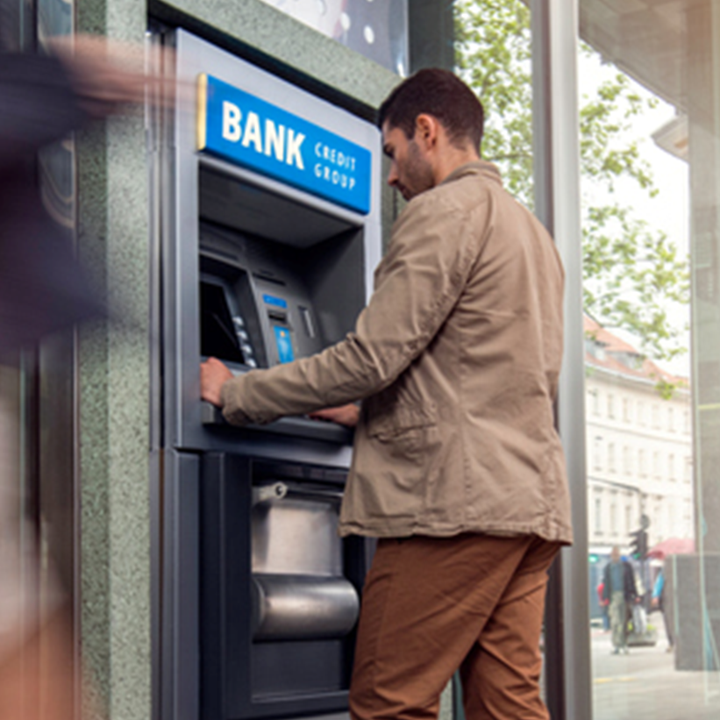

Slide 11
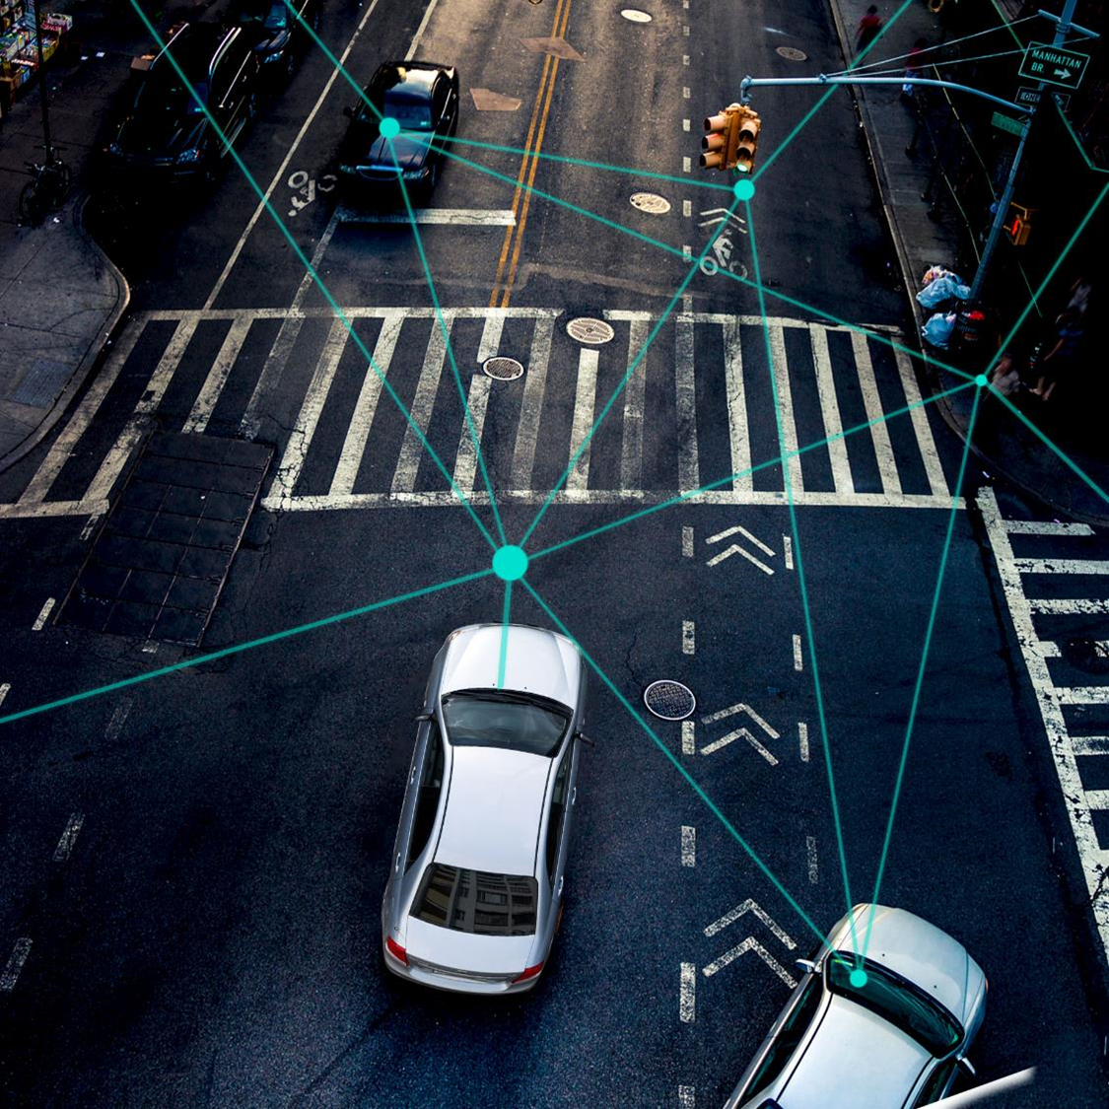

Slide 12
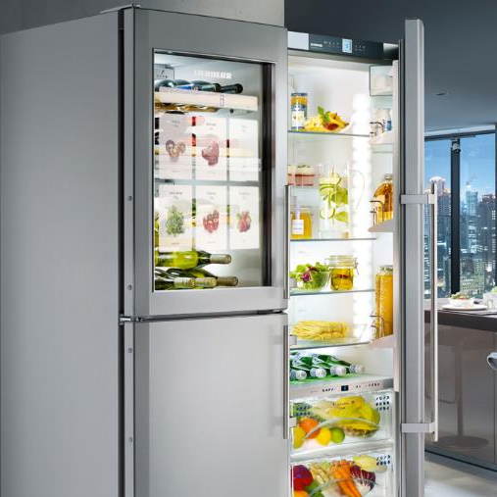

Slide 13
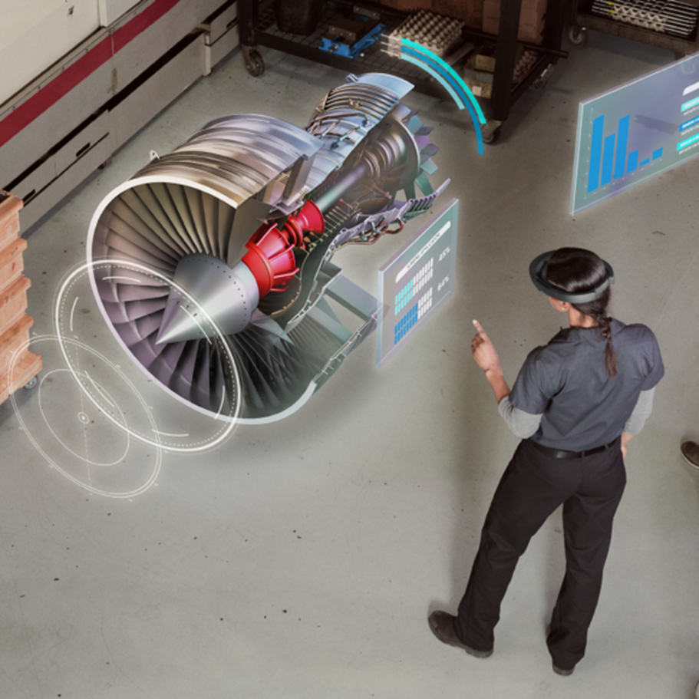

Slide 14
Opportunity
&
Responsibility

Slide 15
Privacy
Opportunity
&
Responsibility
Cybersecurity
Ethical AI

Slide 16

Microsoft mission
Empower every person and every organization on the planet to achieve more

Slide 17
Gaming
People-centered experiences
Modern life
Empowered experiences
AI
Modern workplace
Business applications
Intelligent Cloud
Digital transformation
Ubiquitous computing
Applications & infrastructure
Intelligent Edge
Data & AI

Slide 18
Gaming
People-centered experiences
Modern life
Empowered experiences
Modern workplace
AI
Business applications
Intelligent Cloud
Digital transformation
Ubiquitous computing
Applications & infrastructure
Data & AI
Intelligent Edge

Slide 19
People-centered experiences
AI
Ubiquitous computing
Intelligent Cloud
Intelligent Edge

Slide 20
Azure
:
the world’s
computer

Slide 21
:
Azure
Azure Stack
Azure IoT Edge
Azure Sphere

Slide 22



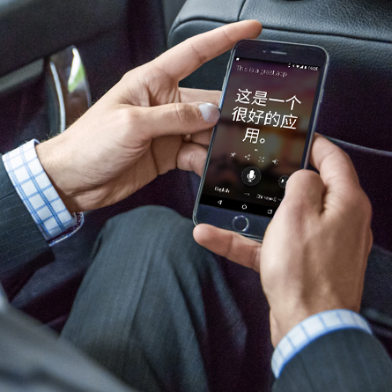
People-centered experiences
AI
Intelligent Cloud
Intelligent Edge
Ubiquitous computing
Microsoft AI breakthroughs
96%
RESNET vision test 152 layers
Switchboard
Meeting speech
5.1%
Switchboard speech recognition test
Broadcast speech
Switchboard cellular
IBM Switchboard
88.5%
SQuAD reading comprehension test
69.9%
MT research system
2016
Object recognition Human parity
2017
Speech recognition Human parity
January 2018
Machine reading comprehension Human parity
March 2018
Machine translation Human parity

Slide 23
AI
Intelligent Cloud
Intelligent Edge
Microsoft AI breakthroughs
Switchboard
Meeting speech
96%
RESNET vision test 152 layers
5.1%
Switchboard speech recognition test
88.5%
SQuAD reading comprehension test
69.9%
MT research system
Broadcast speech
Switchboard cellular
IBM Switchboard
2016
Object recognition Human parity
2017
Speech recognition Human parity
January 2018
Machine reading comprehension Human parity
March 2018
Machine translation Human parity

Slide 24



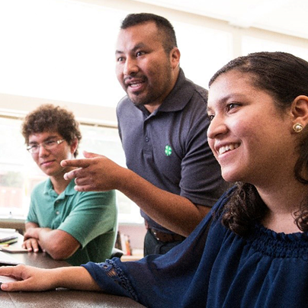


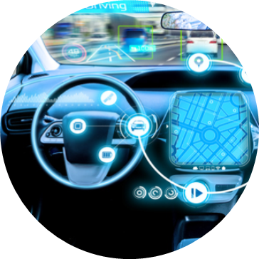


Microsoft AI breakthroughs
69.9%
MT research system
88.5%
SQuAD reading comprehension test
Switchboard
Meeting speech
5.1%
Switchboard speech recognition test
Broadcast speech
Switchboard cellular
IBM Switchboard
March 2018
Machine translation Human parity
96%
RESNET vision test 152 layers
January 2018
Machine reading comprehension Human parity
2017
Speech recognition Human parity
2016
Object recognition Human parity
Retail
Manufacturing
Healthcare
Democratizing AI
Education
Democratizing AI
Agriculture
Media & Communications
Automotive
Financial

Slide 25
People-centered experiences
Intelligent Cloud
Intelligent Edge
AI
Ubiquitous computing

Slide 26
Multi-sense, multi-device
Activities & tasks
People-centered experiences
Relationships
Gaming
Microsoft 365
Dynamics 365

Slide 27
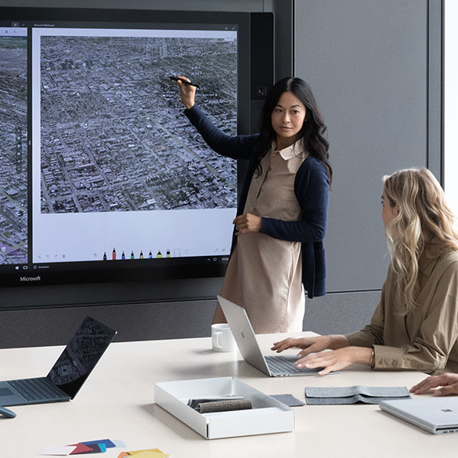
Demo
Modern meetings
Raanah Amjadi
Teams Product Marketing Manager
Sonia Dara
Surface Product Marketing Manager
Daniel Escapa
Principal Program Manager
Andre Player
Managing Director Valorem
CULTURE
Growth mindset
Customer obsessed
Diverse & inclusive
One Microsoft

